Slide 1
BLG102E Extra Session
Pointers and Strings
Res. Assist. Neşe Güneş & Res. Assist. Meral Korkmaz Kuyucu 6 May 2020

Slide 2
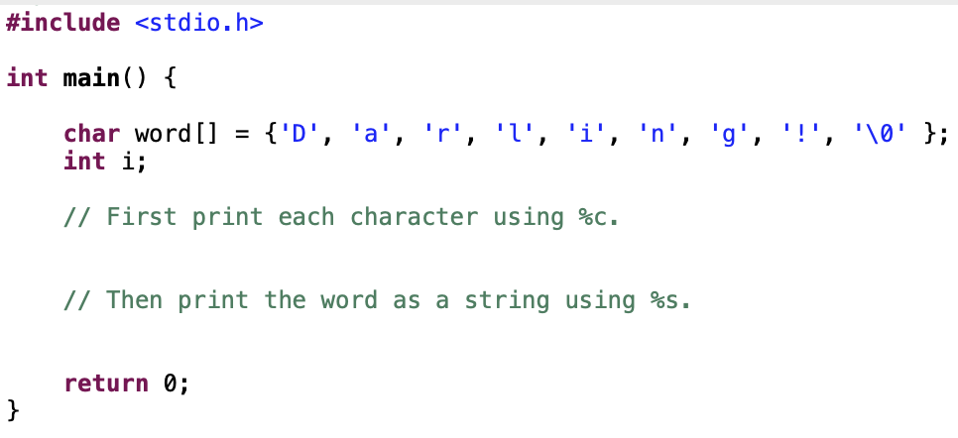
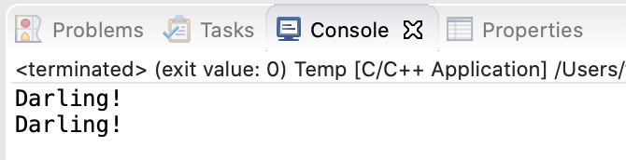
1. An array of characters
Write a program to print a word which is stored in an array of characters.
First use %c which is for formatting chars
Then use %s which is for formatting strings

Slide 3
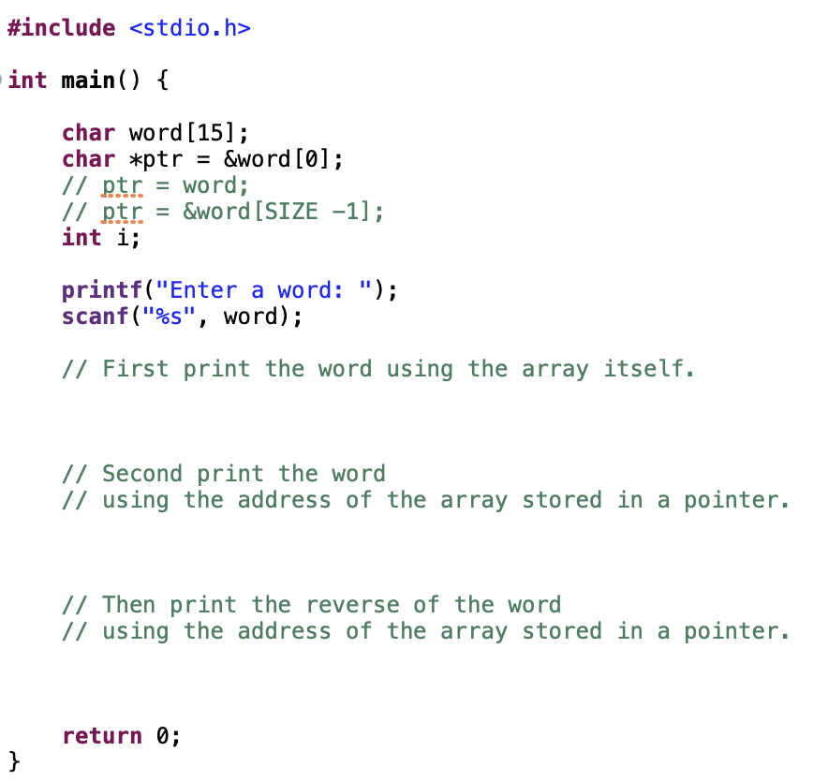
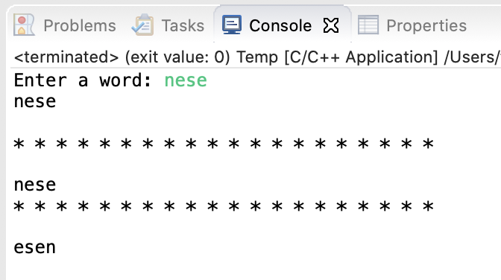
2. Address of an array
Write a program to print a word stored in an array using a pointer which stores the address of the array.
First print the word using the array itself.
Second print the word using the address of the array stored in a pointer.
Then print the reverse of the word using the address of the array stored in a pointer.

Slide 4
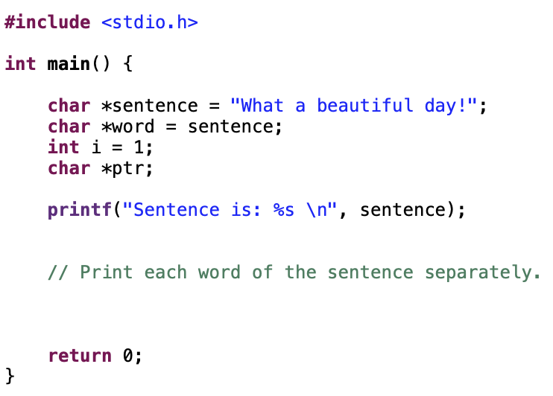
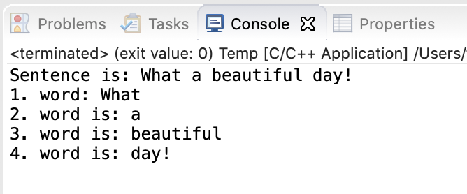
3. Separate the sentence
into phrases
Write a program to print each word of a sentence separately using whitespace character ‘ ’ as a separator.
First print the first word of the sentence as we don’t have a whitespace character before the first word.
Then print the rest of the words using blank ‘ ’ as a separator.

Slide 5
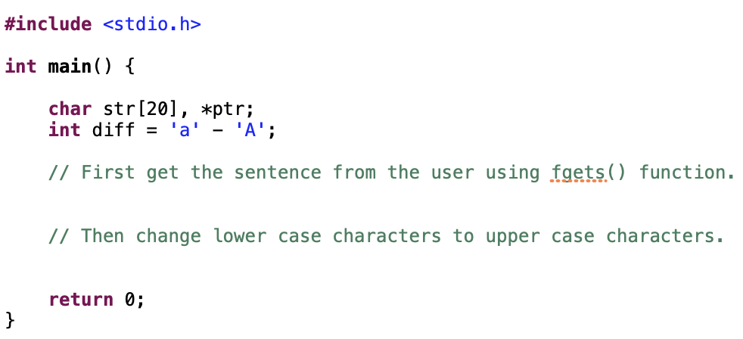
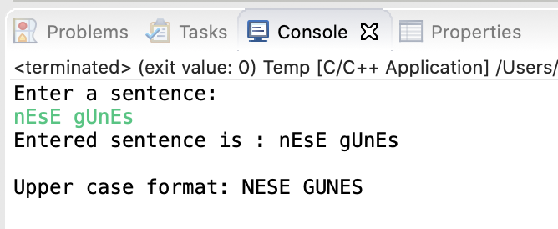
4. Upper case format
of a string
Write a program to get upper case version of a string.
First get the sentence from the user using fgets() function.
Then change lower case characters to upper case characters.
Remember upper case ‘A’ is 65, lower case ‘a’ is 97 in ASCII Table.

Slide 6
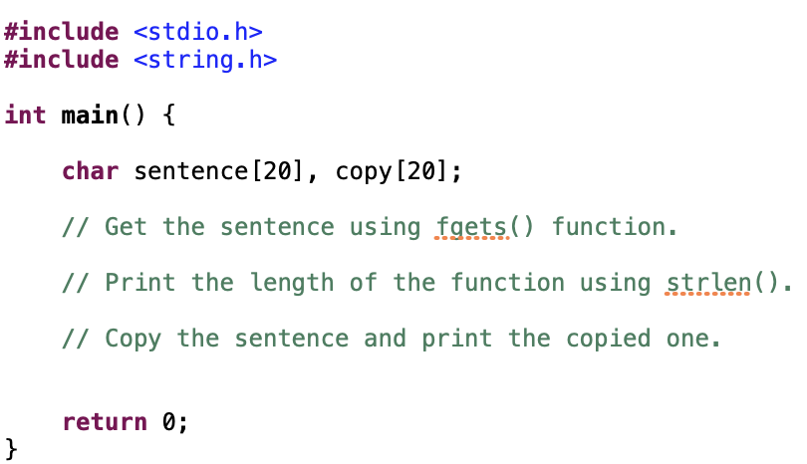
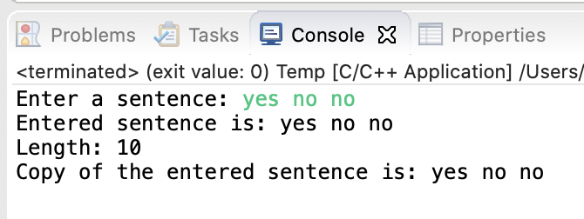
5. Length of a string
Standard C library functions
Write a program to calculate the length of string using standard C library function strlen().
First get the sentence from the user using fgets() function.
Next print the length of the string using strlen().
Then use strcpy() function and print the copied sentence.

Slide 7
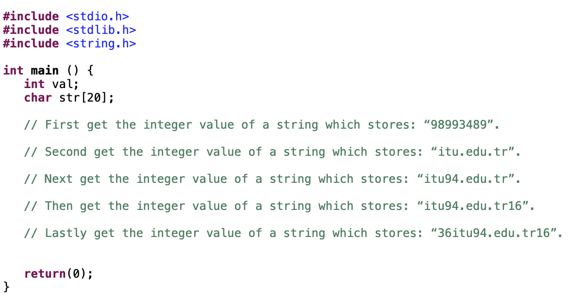
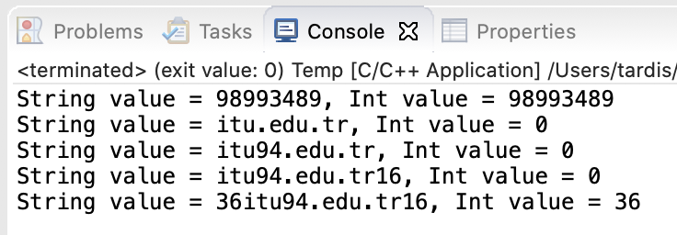
6. Convert string to integer
using atoi() from <stdlib.h>
Write a program to get the integer value of a string using C standard library function atoi(), note that we must include <stdlib.h>.
First get the integer value of a string which stores: “98993489”.
Second get the integer value of a string which stores: “itu.edu.tr”.
Next get the integer value of a string which stores: “itu94.edu.tr”.
Then get the integer value of a string which stores: “itu94.edu.tr16”.
Lastly get the integer value of a string which stores: “36itu94.edu.tr16”.

Slide 8
Good luck.

